Slide 1
Flynns clssification

Slide 2
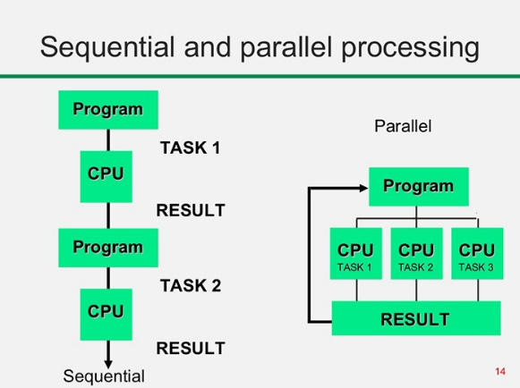
Sequential VS Parallel Processing

Slide 3
Multiprocessor VS Multicomputer
Features | Multiprocessor System | Multicomputer System
Definition | Multiprocessor consists of multiple processors within a single computer. | Multicomputer is an interlinked multiple autonomous computer.
Communication between processing elements | It requires proper communication between the processing components and memory for successful resource allocation. | There is no interaction between processor units or memory resources.
Another name | It is also known as the tightly coupled system. | It is also known as loosely coupled systems.
Computing | It supports parallel computing. | It supports distributed computing.

Slide 4

Working Principal of a Processor
A Microprocessor Simply Executes Programs where programs describes instructions and Data.
The microprocessor follows a sequence to execute the instruction: Fetch, Decode, and then Execute.

Slide 5
Architectural Classification Scheme
Feng’s Classification:
  Serial Vs Parallel Processing
  WSBS, WPBS, WSBP, WPBP
Handler’s Classification:
  Degree of Parallelism and Pipelining
  PCU, ALU, BLC
Flynn’s Classification:
  Instruction Stream and Data Stream
  SISD, SIMD, MISD, MIMD
WSBS = Word Serial Bit Serial
WPBS = Word Parallel Bit Serial
WSBP = Word Serial Bit Parallel
WPBP = Word Parallel Bit Parallel
PCU = Processing Control Unit
ALU = Arithmetic Logic Unit
BLC = Bit Level Circuitry
SISD = Single Instruction Single Data
SIMD = Single Instruction Multiple Data
MISD = Multiple Instruction Single Data
MIMD = Multiple Instruction Multiple Data

Slide 6
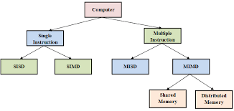
Flynn’s Classification
Michael Flynn introduced a classification of various computer architectures based on notions of instruction and data streams. They are SISD, SIMD, MIMD, MISD.
an instruction stream refers to the sequence of instructions a CPU reads and executes from memory, while a data stream refers to the sequence of operands or data that the instructions operate on.

Slide 7
SISD
Conventional sequential machines are called SISD (Single Instruction Stream Over Single Data Stream) computers.
They are also known as Uniprocessor Systems.
Non Parallel Computers although parallel processing can be done through pipelining.
Example: Microcomputers, Mainframes, IBM 7001 etc.

Slide 8
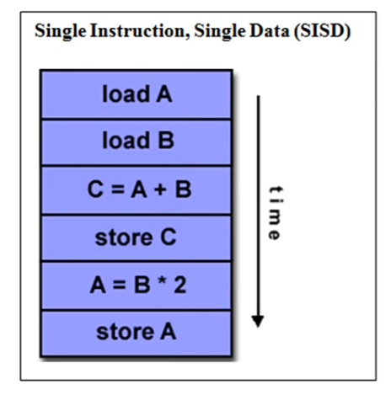
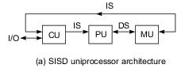
SISD

Slide 9
SIMD
Capable of executing the same instruction on all the CPU’s but operating on different data items.
Well suited for Scientific Computing.
Example: Array Processors, Vector Pipelines.

Slide 10
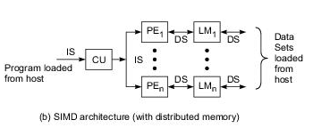
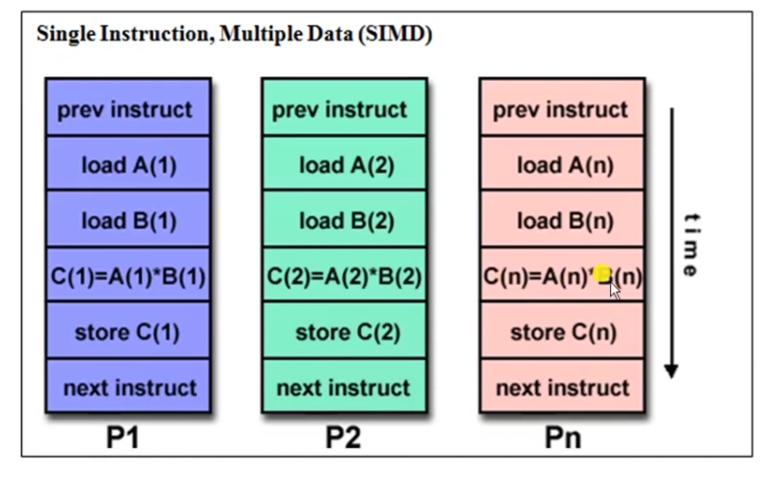
SIMD

Slide 11
MISD
In MISD (Multiple Instruction Streams and a Single Data Stream) the same data stream flows through a linear array of processors executing different instruction streams.
This Model is Practically not useful in most applications.
Example: Systolic Arrays.

Slide 12
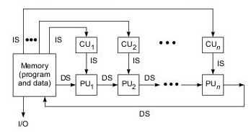
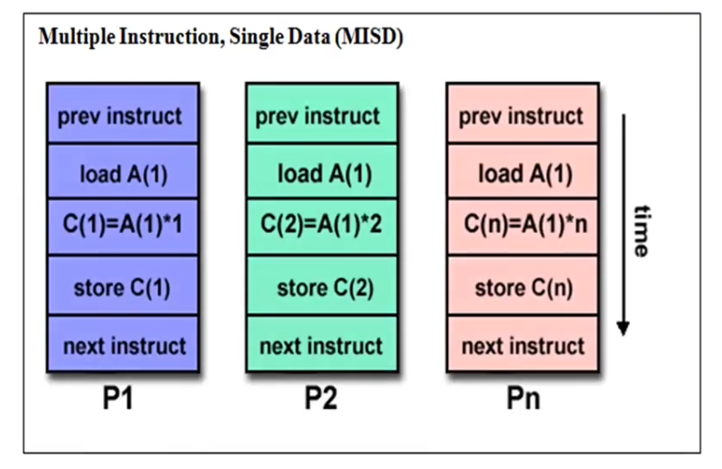
MISD

Slide 13
MIMD
Parallel Computers are reserved for MIMD (Multiple Instruction Streams Over Multiple Data Streams)
Among the four MIMD is the most popular model
Example: Supercomputers, IBM 370, Cray-2 etc.

Slide 14
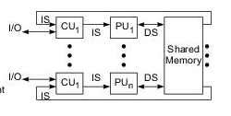
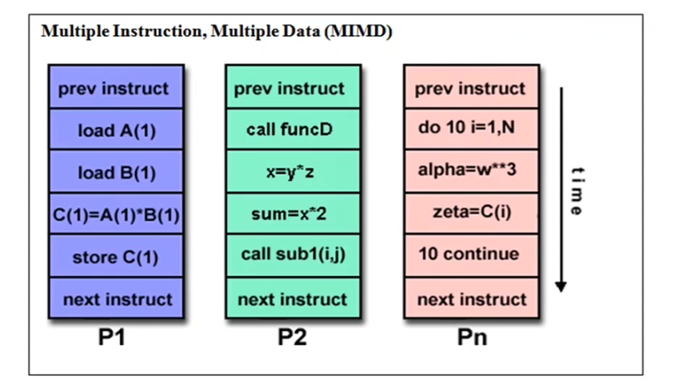
MIMD

Slide 15

That’s All for today.
Thank You.

